Slide 2
Andreas Dreyer Hysing
Stretching for Zero Downtime Upgrades in Azure

Slide 3
Part 2

Slide 4

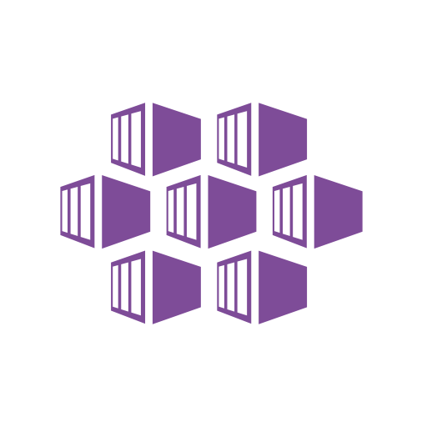

Quick recap
No maintainance No control
SAAS
High maintainance Thight control
IAAS
Notes:
So far Sven has thought us how AKS is a stable hosting environment for applications running in the cloud. In fact I would go so far as saying that it is saying that kubernetes is the de facto standard for mission critical hosting environments.
However we have demonstrated by now that upgrading AKS from one version to the next requires thoughtful planning and preparation.
Some of you might be thinking. Is there not a better way to manage servers?
If we could work on a higher level. Then we could spend less time managing servers. We want the lest level of maintainance, like in Software as as Service (SaaS), with the same tight control we have with Infrastructure as as Serice (IaaS).

Slide 5



Hosting Alternatives on Azure
Azure Functions
managed
Scaling based on event hub queues
Well suited for APIs and background processing
Azure app services
Easy to use
suited for web apps
scaling on CPU or memory
Azure Kubernetes Services (AKS)
Mighty. And effective
Requires thoughtfull planning of upgrades
Notes:
So what are the alternatives for hosting on azure today?
We AKS. It is might and effective.
Then we have azure app services. It is simple to use, but is most suited for web apps. Also the scaling part is only based on CPU and memory only.
Then we wave Azure functions. Functions are managed by Microsoft. It has scaling based on CPU, memory or the size of eventhub queue, and is well suited for both APIs and background processing. Unfortunately, Due to the way functions are built, you can not expect them to serve 24-7 out of the box. We have seen in our company that there are downtime windows on the azure functions platform itself. There are ways around this tho.

Slide 6
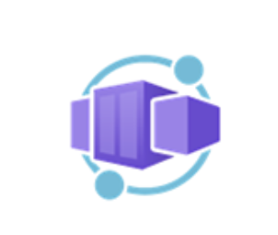
Azure Container Apps
Container Apps is a new product by microsoft which is Generaly Available
It runs on Azure Kubernetes Services (AKS). It is abstracting away most of the management.
It runs a collection of many containers
Benefits
Automatic upgrades 🎉
Security best practices 😎
KEDA Event Driven Autoscaler based on Event Hub queues or http requests 👏
Dapr (APIs for building portable and reliable microservices)
Notes:
Enter azure container apps.
It is a new product from microsoft which is still in preview.
It runs on top of AKS, but abstracts away all the management. It can run a collection of containers and has powerfull scaling.

Slide 7
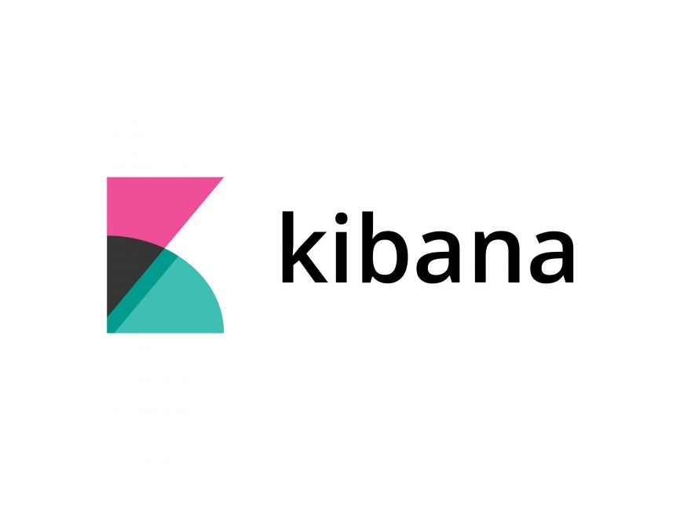
Notes:
So let us do a demo. You guys likes demos right?
So this example we found an an application called called Kibana. Some of you might know it.

Slide 8

ENVIRONMENT TEST
CONTAINER APP KIBANA
EXTERNAL INGRESS
REVISION V1 AND V2
CONTAINER APP ELASTIC
INTERNAL INGRESS
REVISION V1
Notes:
For the demo we are going to set up an environment “test”. It is marked with the blue box on the figure.
Then we are going to put two container apps, kibana and elasticsearch, into this environment.These are marked with gray boxes.
Off course we are going to accept traffic. Kibaina accepts traffic from the internet with an external ingress, while elasticsearch will only accept traffic from kibana through an internal ingress.
Each application will have many revisions. We will get back to that.
To set this example we will use the bicep language.

Slide 9
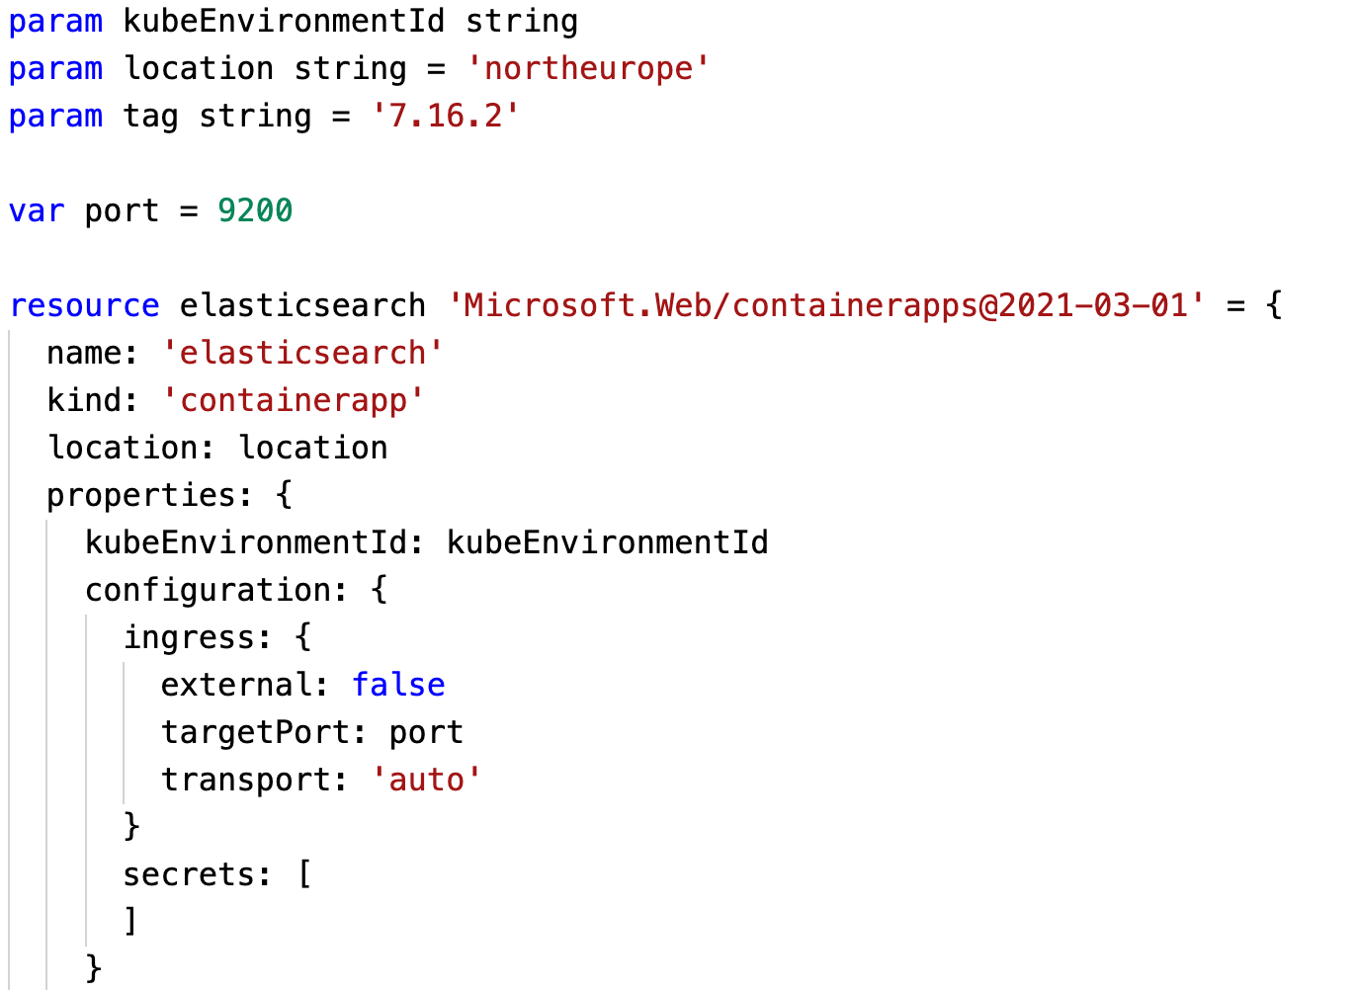
Notes:
THIS PART WILL BE DONE INTERACTIVELY FROM VISUAL STUDIO CODE AND THE COMMAND LINE.
The first thing we need is elasticsearch.
This is how we define elasticsearch with bicep.
Notice is how the ingress is marked as external:false and targetPort 9200. That is the port on the docker container. It is right in the middle of the screen. This means elasticsearch can only communicate with other applications in the environment.

Slide 10
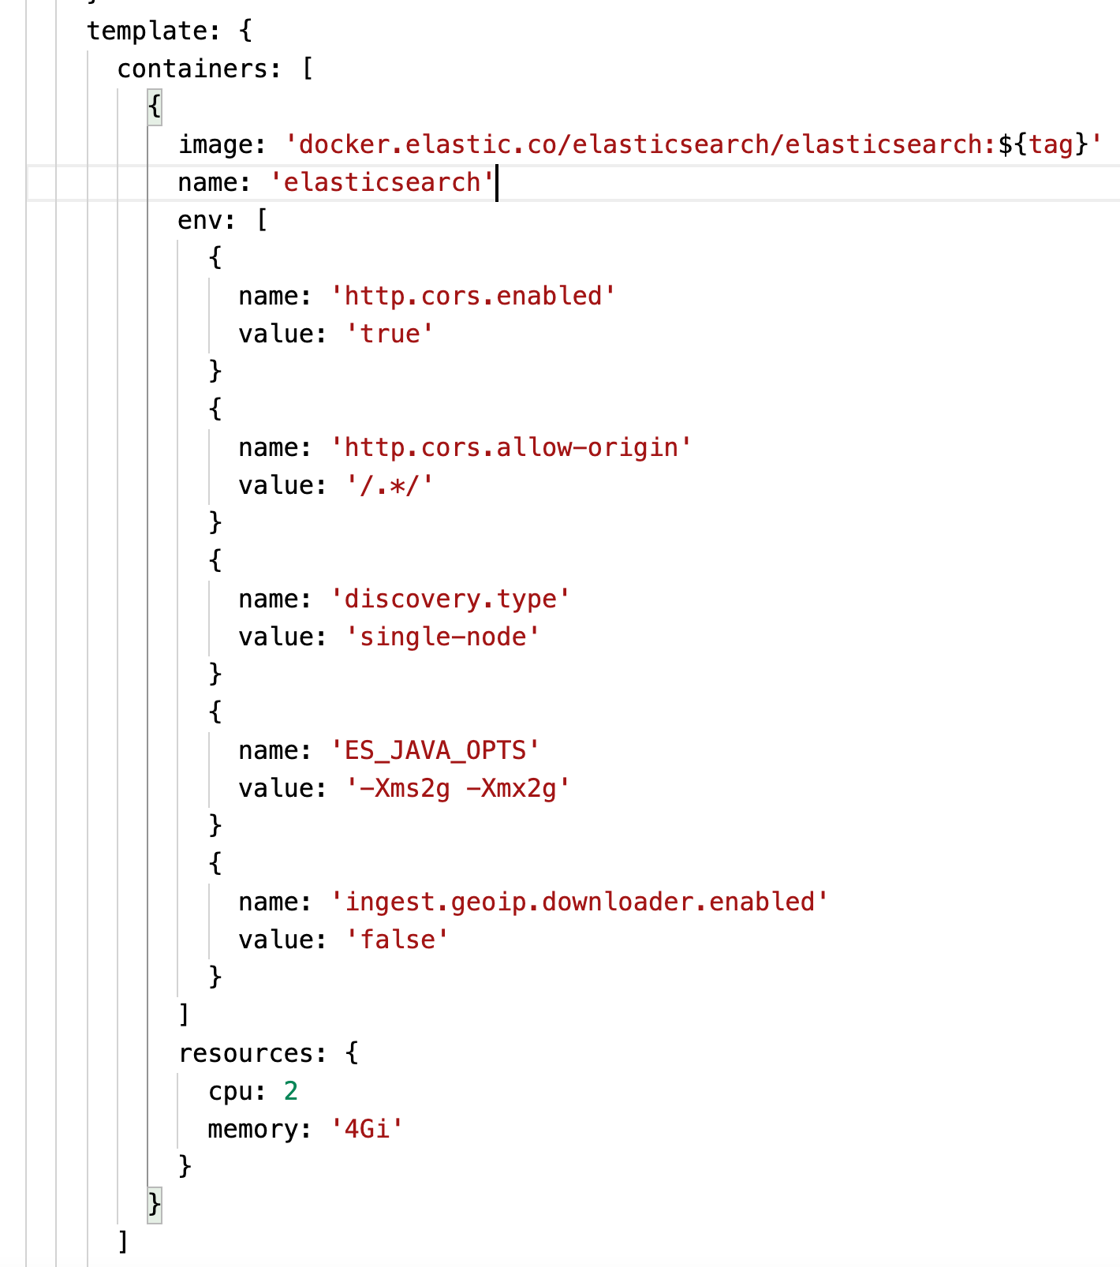
Notes:
No web application is complete without environment variables. This is how we define them in bicep. They are bundled with the docker image and tag. If you need a new version then you create a revision and repeat the new environment variables with the new version of the image.

Slide 11
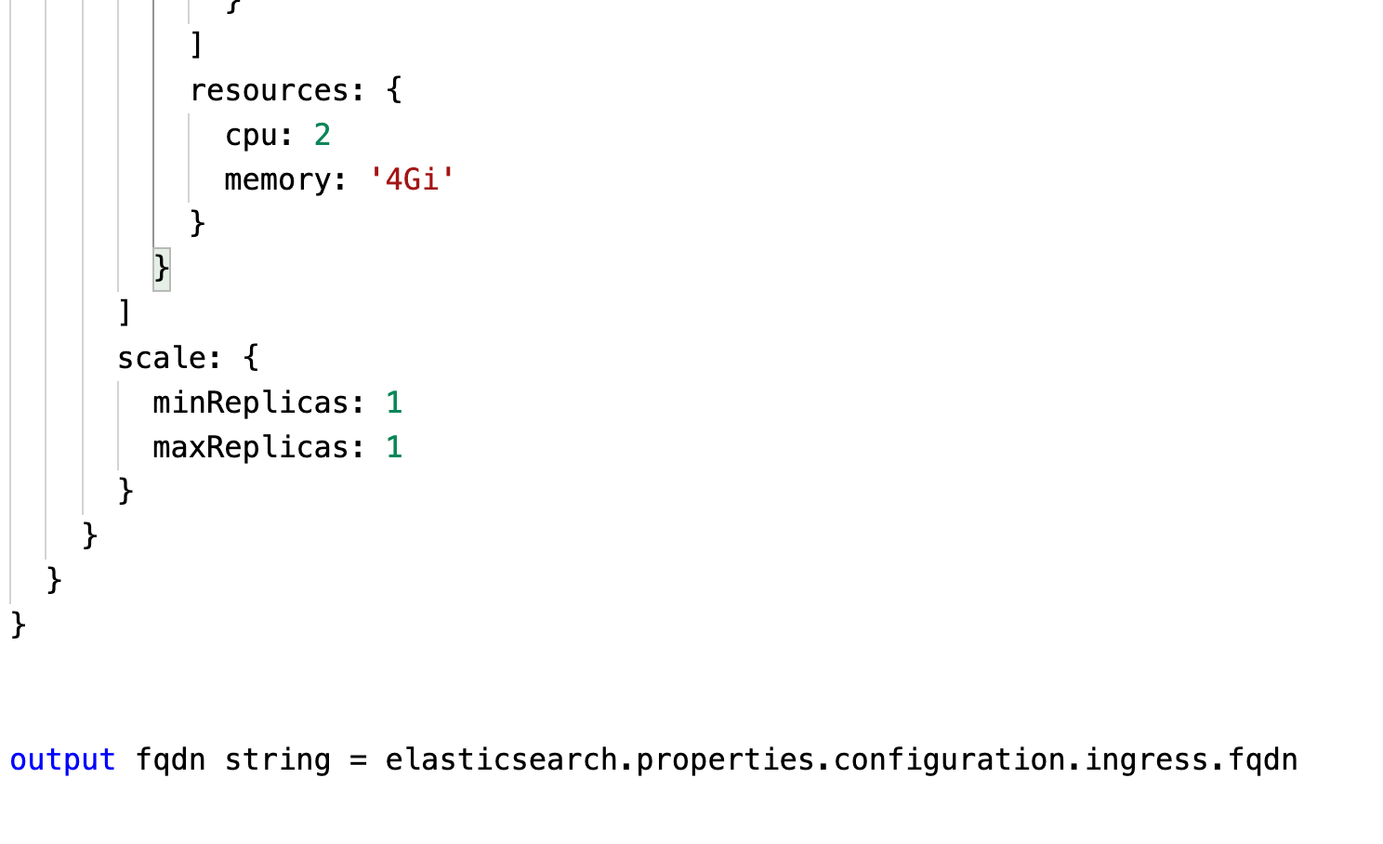
Notes:
The scaling of elasticsearch is fixed. We want one instance as you can see in the middle of the screen.
I the end we want to store the fully qualified domain name or FQDN, and output it to the next bicep file.

Slide 12
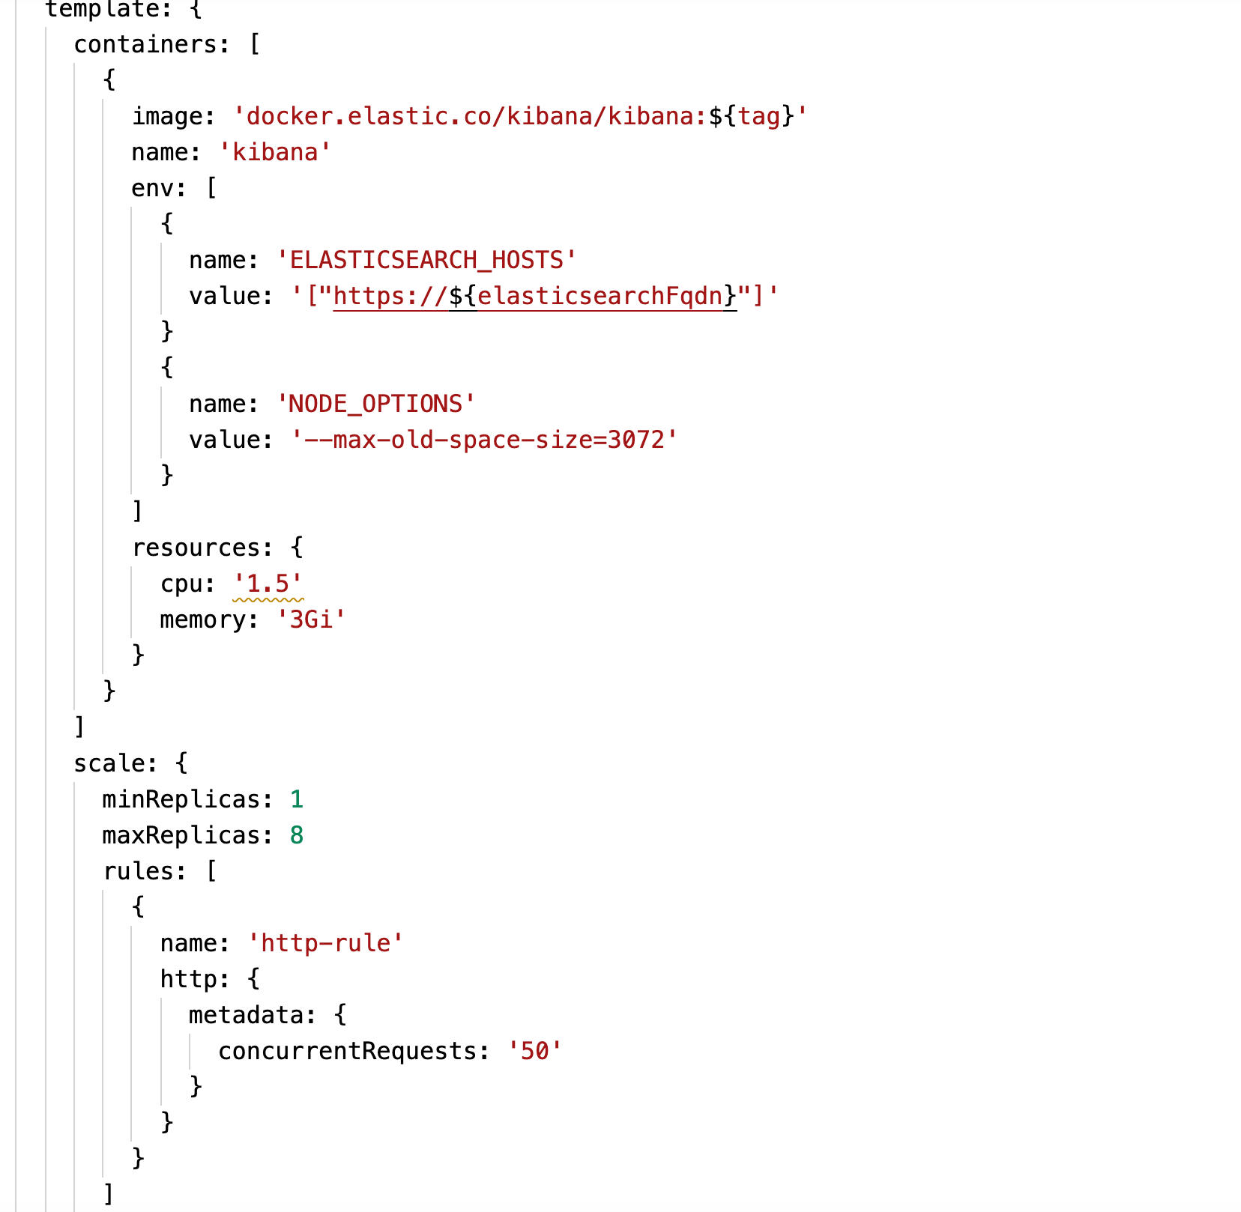
Notes:
Kibana is set up in a similar manner.
A docker container, with some environment variables.
It scales from 1 to 8 instances depending on HTTP requests
It is time for showing hands on, but first we need to talk about logging

Slide 13
Reading system logs
System logs can only be read through Azure Log Analytics
ContainerAppConsoleLogs_CL | where ContainerName_s <> 'daprd' | project Log_s, TimeGenerated, ContainerAppName_s, ContainerName_s | order by TimeGenerated desc
Notes:
Reading system logs can done with Azure log analytics. The application writes logs wit a fixed scama that you can query with this expression.
So remember to set up azure log aqalytics.

Slide 14
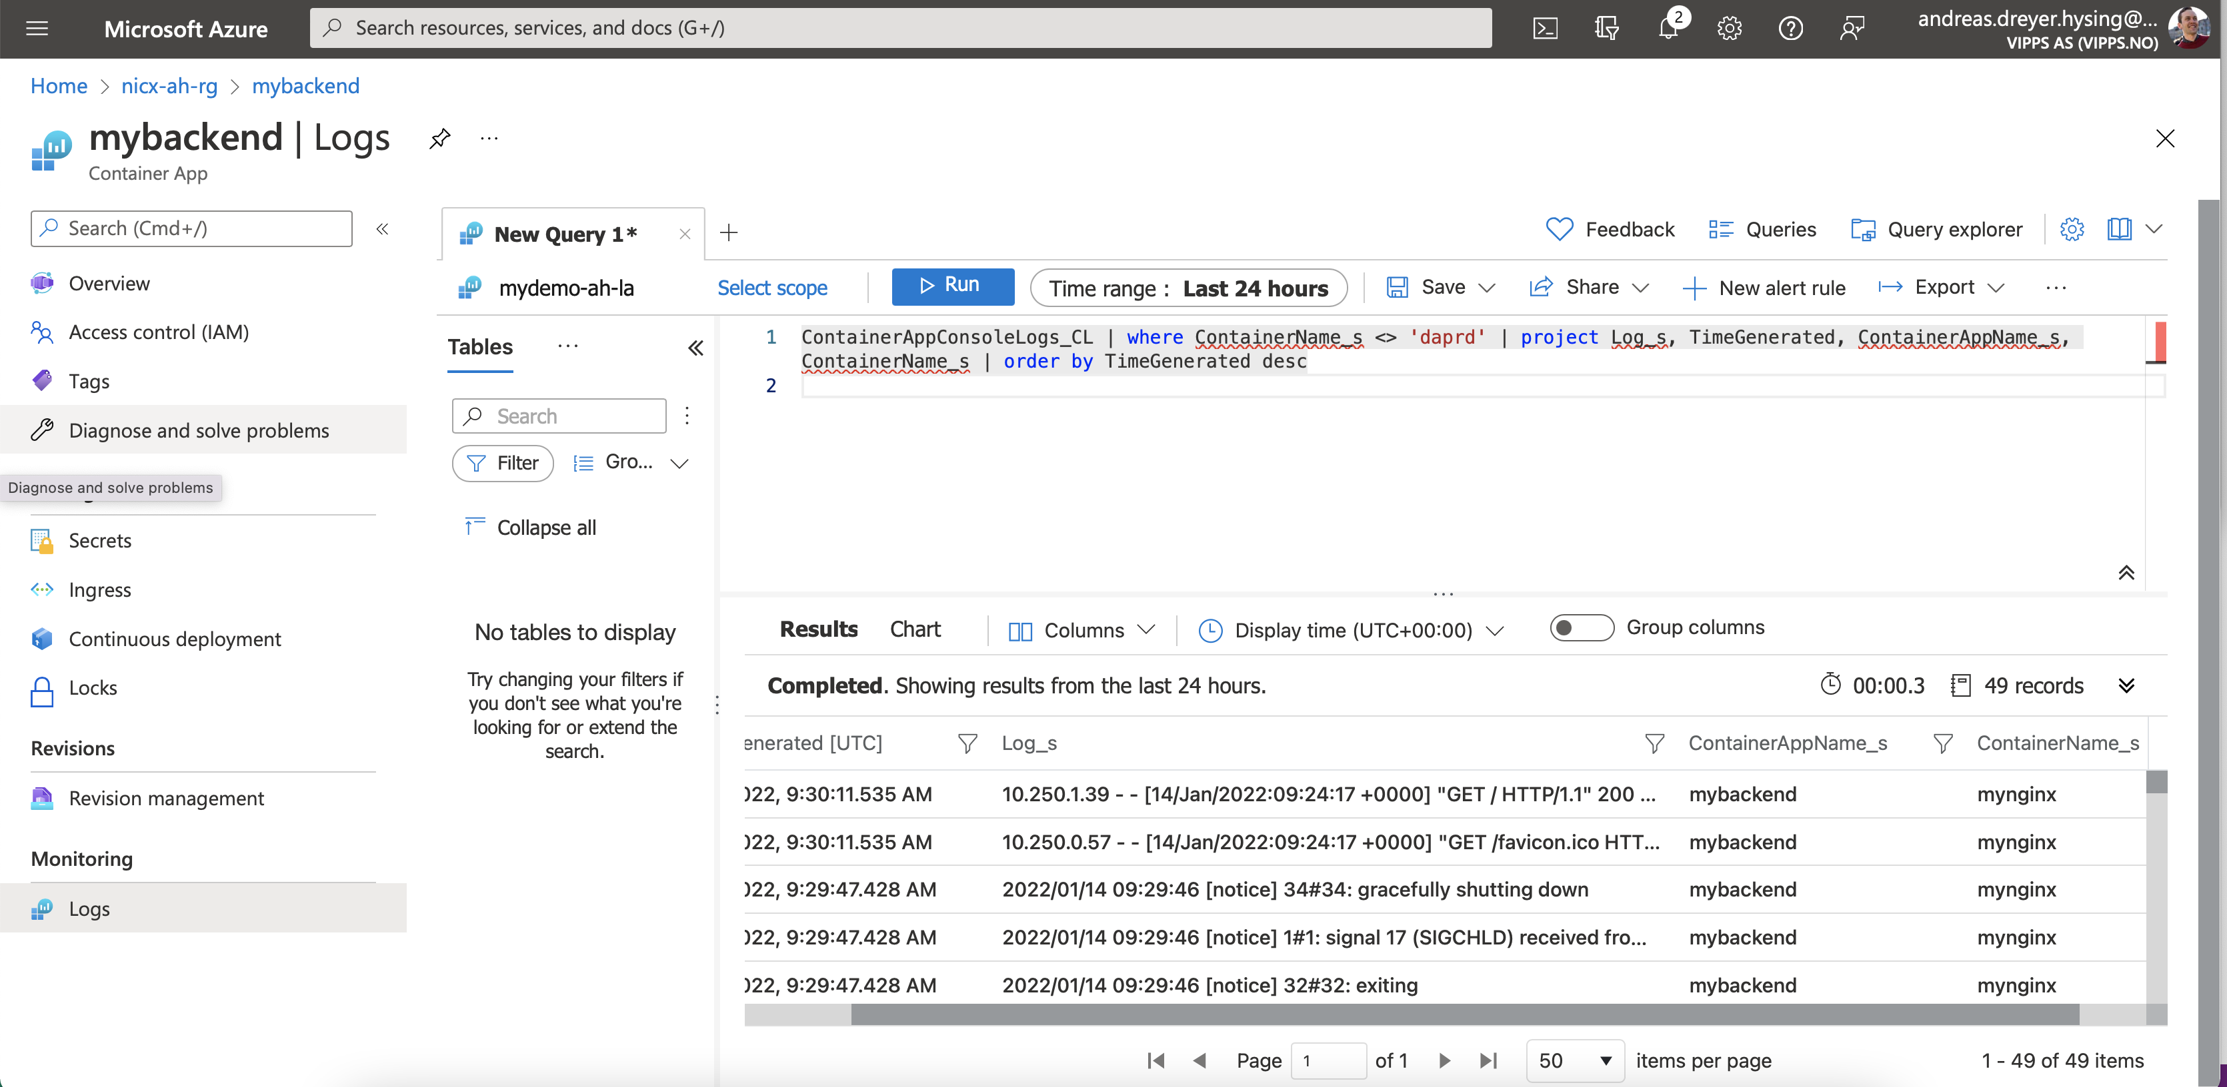
Light, media/text right
Notes:
When you have done so your log lines in will show up in log analytics as column Log_s
Let’s do hands on.

Slide 15
What we saw
Azure Container apps
A comparison with other hosting alternatives
Demo of Kibana
A working example with ingress and environment variables.
Logging to log analytics
Notes:
To sum it up.
We have now seen the benefits of azure container apps.
We saw a comparison to other hosting alternatives on azure.
We have seen a working demonstrations with kibana, environment variables and ingress.
I think container apps looks really promising. It can become a great product once it leaves preview. Nowever, As I am kubernetes operator I have a hard time believing that docker images has the same life cycle as the cluster. I don’t think they should be deloyed with the same code which provisions the cluster. We ill see if the community want to keep containers and hosting responsibilities together or separate.
I imagine that container apps will be best suited for test environments in Vipps.
Back to you Sven.

Slide 16
Slides and demos from the conference will be available at
https://github.com/nordicinfrastructureconference/2022

